Slide 1


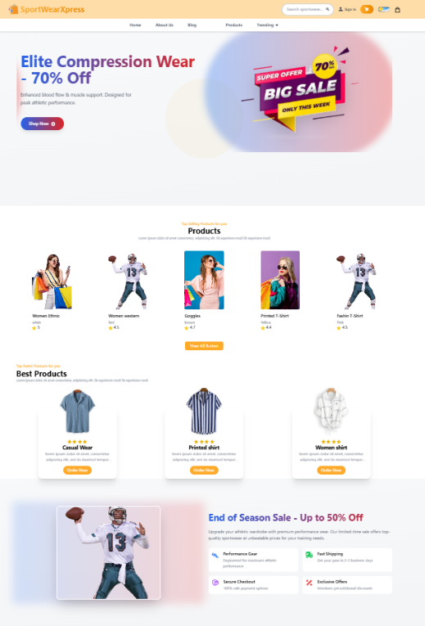
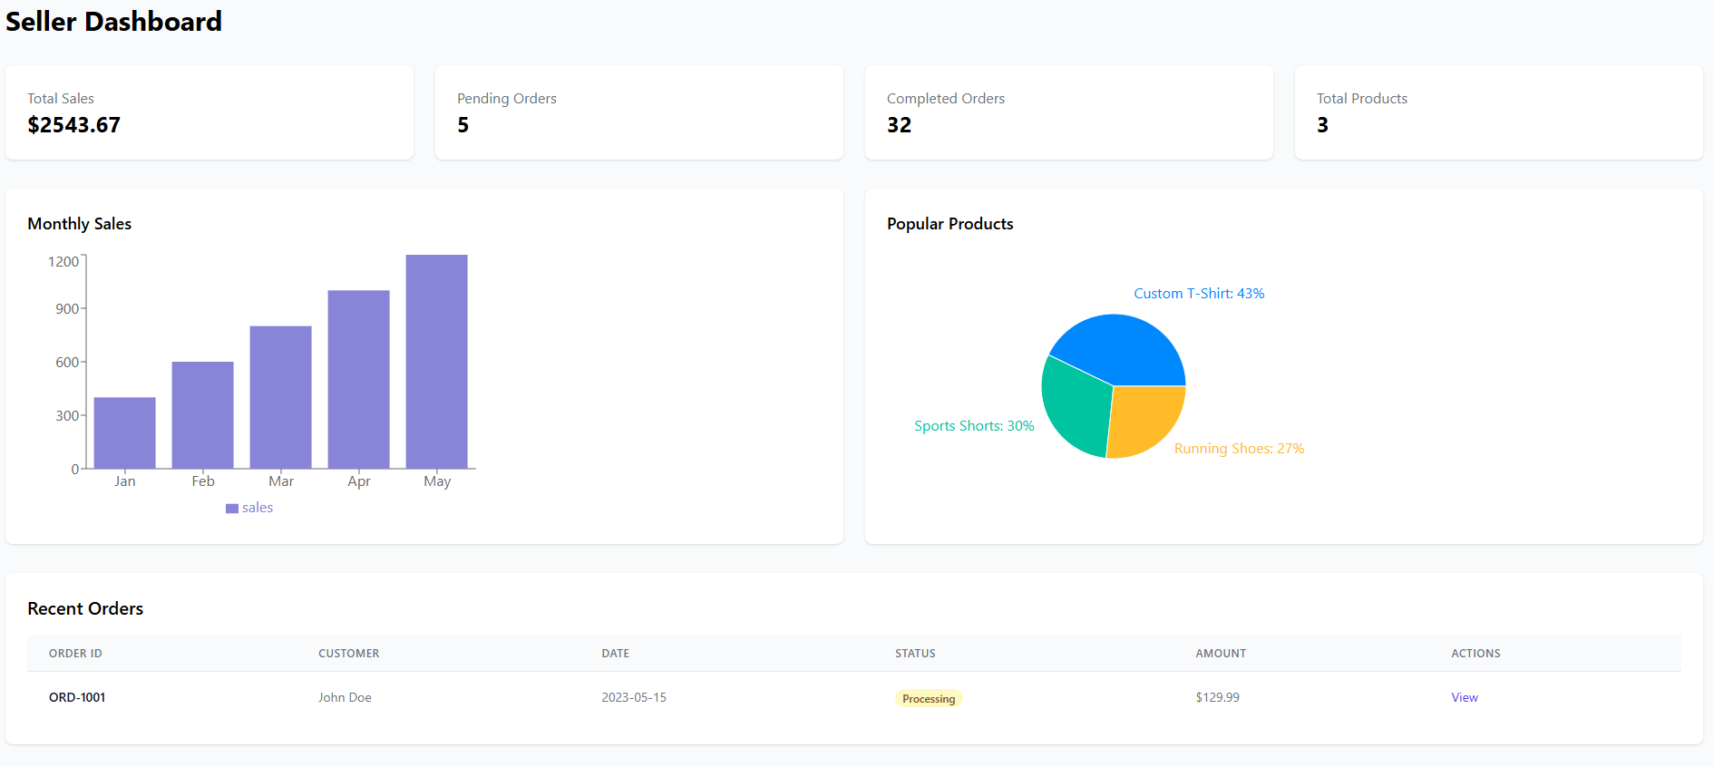
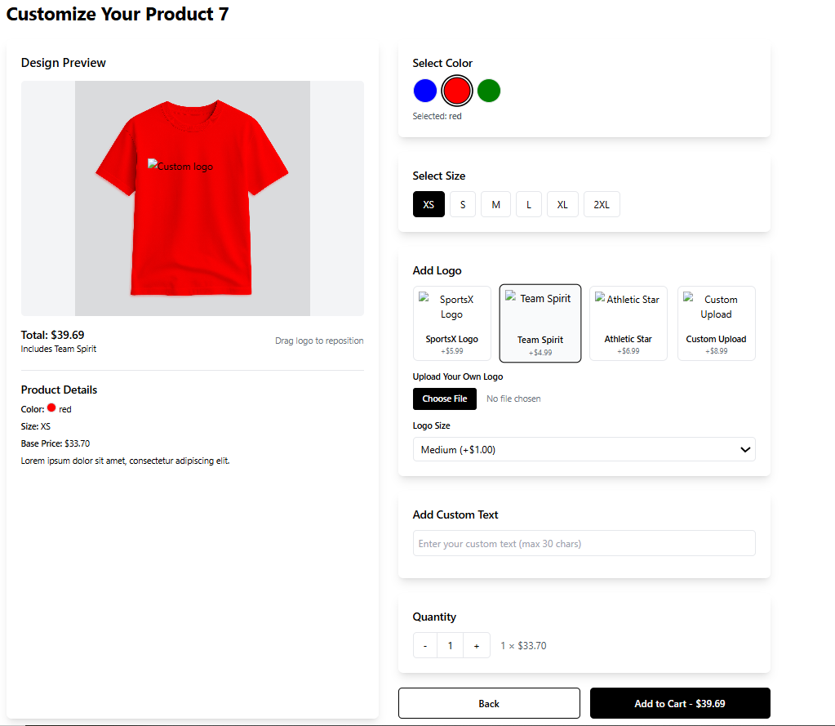
SportWearXpress
Anum Mustaqeem
Muneeb Butt
Qasim Abbas
Awais Akram
F24SE002
Abstract
The SportswearXpress project introduces an AI-enhanced e-commerce platform designed for personalized sportswear customization. The system addresses challenges commonly found in traditional platforms, such as lack of precision in design tools, limited real-time interaction, and absence of dynamic pricing. By integrating AI-guided design assistance, real-time communication between buyers and sellers, and a pricing model that adapts based on customization complexity, SportswearXpress improves both the customer experience and operational efficiency. The platform represents a scalable, browser-based solution aimed at raising the standards of sportswear customization.
Introduction
Traditional sportswear customization platforms often fall short in delivering intelligent design guidance, clear pricing, and seamless communication. SportswearXpress addresses these shortcomings by incorporating artificial intelligence to assist users in real time, enabling precise and intuitive product customization. It features dynamic pricing that adjusts automatically based on the complexity of the design and facilitates direct communication between users and sellers to eliminate delays and misunderstandings. The platform aims to streamline operations, minimize errors, and enhance the shopping experience. Furthermore, it empowers both customers and sellers through an interactive interface designed for high usability and efficiency.
Methods and Materials
SportswearXpress is built using a modular and scalable architecture that supports real-time interaction and AI-driven customization. The front end uses React.js for a responsive interface, while Node.js with Express.js powers the backend. AI features like design suggestions are implemented using TensorFlow.js and OpenCV.js, enabling real-time processing in the browser. MongoDB handles flexible data storage, and Socket.io enables live buyer-seller communication. OAuth 2.0 ensures secure authentication. The system is locally hosted for testing but designed for future cloud deployment. Development was managed through GitHub, with coordination via Trello and Slack.
SportsWearXpress-AI-Enhanced
Discussion
The modular design of SportswearXpress allowed for smooth integration of AI features and real-time systems, facilitating focused development of individual components. The architecture is scalable and adaptable for future migration to cloud infrastructure. One of the key strengths observed during development was the system's ease of use, which resulted in improved user engagement and fewer errors during testing. However, working with MongoDB's flexible schema required careful planning to maintain data integrity across modules. Future enhancements are planned to introduce augmented reality-based design previews, gamification features such as achievement badges, and integration with third-party services like payment gateways and marketing analytics tools.
User Interface
Results
The platform development is currently 75% complete, with most of the core functionality implemented and tested. Out of 16 planned functional modules, a majority have been fully developed, including AI-assisted customization, dynamic pricing, buyer-seller chat, and basic analytics on the admin dashboard. A total of 32 test cases were executed, with most passing successfully, verifying the stability of major features. The system supports secure user authentication, product customization, order placement, and refund processing. Additionally, the platform was tested for mobile responsiveness and cross-device usability. While some advanced modules are still under development, the system has proven to be robust and functionally sound in its current state.
Seller Dashboard
Conclusion
SportswearXpress stands as a promising AI-powered solution for personalized sportswear customization. It successfully merges advanced design tools with real-time communication and dynamic pricing to offer a smooth and engaging user experience. The system has demonstrated stability and scalability through its modular structure, and user interactions have been optimized through an intuitive interface. With most features in place and tested, the platform is well-positioned for future improvements such as AR previews and gamification, making it a competitive solution in the evolving landscape of online sportswear retail.
Product Customization
References
[1] Zazzle, “Zazzle - Customize Anything,” [Online]. Available: https://www.zazzle.com/. [Accessed: 26-
Nov-2024].
[2] Custom Ink,“Custom Ink - Custom T-shirts and More,” [Online]. Available:
https://www.customink.com/. [Accessed: 26-Nov-2024].

